Slide 1
OOP PROJECT IMS

Slide 2
Introduction
Project Name Inventory Management System(IMS)
Group Members Muhammad Ammar(b18101062)
Bilal Ahmed(b18101025)

Slide 3
PROJECT IDEA DESCRIPTION
Ims inventory management system is a management system works to perfom CRUD operations such as Get,Add,Update,Delete inventory
Language java,sql

Slide 4
Oop concepts used
Classes
Objects
Inheritance
Constructor overloading
Overriding
Encapsulation
Static and instance methods
Interface implementation
Static and instance methods
Exception handling
Database

Slide 5
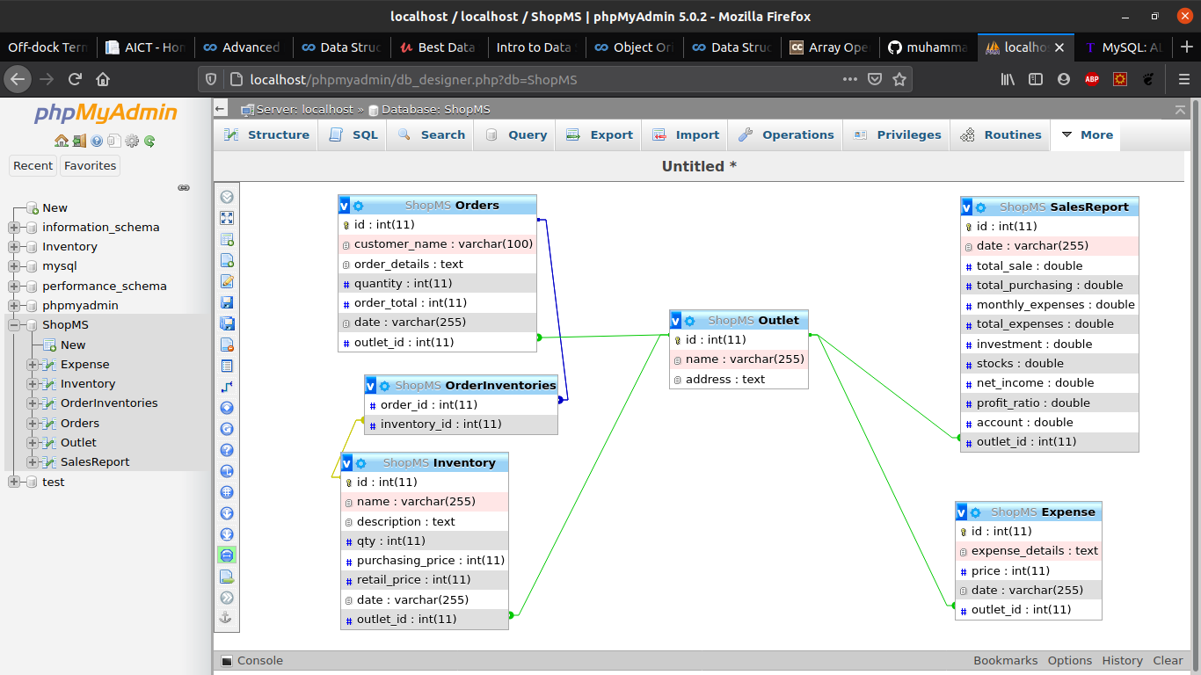
UML

Slide 6
Ims continuation
Ims is the First part of ShopMS after completion
of ims I will be capable of lunching a management system for Shop likes general stores ,electronics appliances shop,Diapers shop etc
Shop MS progress
UML Designed
Data Base Designed
UI/UX is remaing

Slide 7
Thank You

